Slide 1


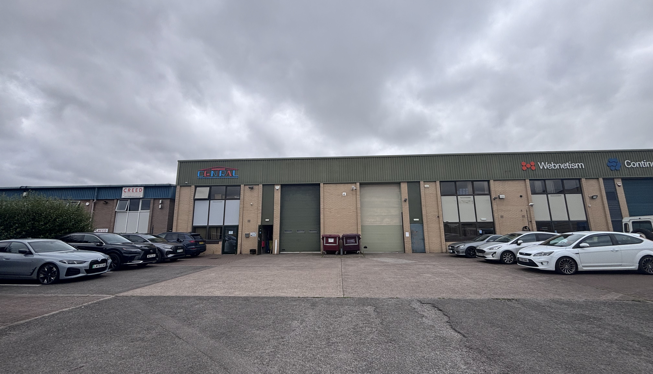

Industrial
Cheltenham
For Sale
From 287.38 m2 (3,093 ft2)
Units C3 & C4 Staverton Technology Park, Herrick Way, Staverton, GL51 6TQ.
www.ashproperty.co.uk/short-url

Slide 2
Units C3 & C4 Staverton Technology Park
Modern industrial units in an accessible location midway between Gloucester and Cheltenham.
Unit C3
The front section of the unit provides reception and office accommodation with separate male and female WCs and a kitchen area. Finishes include a mix of laminate and carpet floor coverings, emulsion painted walls and suspended ceilings with Category 2 strip lighting. Powder coated aluminium windows and doors are fitted with vertical blinds throughout, and the kitchen is equipped with fitted units and a stainless-steel sink and drainer.
To the rear of the main warehouse is a single-storey extension with steel clad elevations and a mono-pitch steel clad roof with a minimum eaves height of 3.37 m (11 ft). The extension is accessed from the main warehouse via a pedestrian door and incorporates a fire escape.
A steel-framed mezzanine sits above the reception area divided between open storage and two enclosed offices and is accessed via a steel staircase from the main warehouse floor and is finished to a similar specification, with carpet, emulsion painted walls and ceilings, Category 2 strip lighting and powder coated aluminium windows with vertical blinds.
The main warehouse is accessed via a sectional overhead loading door and has a painted sealed concrete floor with gas-fired hot air space heating.
Unit C4
The ground floor comprises predominantly warehouse accommodation, with the front section providing reception, office, store, WC and kitchen facilities. Finishes throughout include a mix of laminate and carpet floor coverings, emulsion painted walls and Category 2 strip lighting, with powder coated aluminium windows and doors fitted with vertical blinds. The kitchen is equipped with fitted units and a stainless-steel single drainer sink.
A staircase from the ground floor reception gives access to a first-floor corridor, off which are four private offices. The offices benefit from carpet floor coverings, emulsion painted walls and ceilings, Category 2 strip lighting, gas-fired central heating and powder coated aluminium windows with vertical blinds to both front and rear elevations.
The main warehouse is accessed via a sectional overhead loading door and has a painted sealed concrete floor.
Externally, both units benefit from a concrete loading apron together with tarmacadam and block paving car parking, providing approximately seven spaces per unit.
Location
The Technology Park is accessed directly south of the Cheltenham Road (B4063) via Herrick Way. The properties are situated at the rear of the estate, which provides a mix of light industrial /warehouse and office units. Other occupiers on the estate include Creed Catering, BRG Technologies, Virgin Media, Central Cladding and Future Advanced Manufacturing.
Description
Units C3 and C4 comprise mid-terraced and end-terraced industrial/warehouse units respectively, constructed on a steel frame with concrete floors throughout. The front and side elevations are of brick/blockwork construction with profiled plastic-coated steel cladding, internally lined, to the rear elevations. Both units benefit from a mono-pitch roof with a minimum eaves height of 6.14 m (20 ft), finished with insulated profiled steel sheeting incorporating translucent roof lights, supplemented by LED lighting.

Slide 3
Units C3 & C4 Staverton Technology Park
Accommodation (Approx gross internal floor area) | M2 | Ft2
Unit C3
Ground Floor
Industrial warehouse | 174.44 | (1,878)
Office, kitchenette & WCs | 37.02 | (398)
Extension area | 38.90 | (419)
First Floor
Mezzanine area | 37.02 | (398)
TOTAL | 287.38 | (3,093)
Unit C4
Ground Floor
Industrial warehouse | 162.95 | (1,754)
Office, kitchenette & WCs | 52.32 | (563)
First Floor
Offices | 171.61 | (1,847)
TOTAL | 386.88 | (4,164)
Business Rates
The entries listed on the Valuation Office Agency website are:
Unit C3: £20,500
Unit C4: £26,500
Prospective occupiers should check with the Local Authority to establish any transitional relief that may be applicable.
Planning
Within Classes E (previously Class B1) and B8 of the Use Classes Order 1987.
Terms
Each property is offered freehold with vacant possession.
Price
Unit C3 - £375,000
Unit C4 - £495,000
VAT
The properties are elected for VAT.
Energy Performance Certificate
EPCs are being prepared.
Legal Costs
Each party to bear their own legal costs incurred in the transaction.

Slide 4
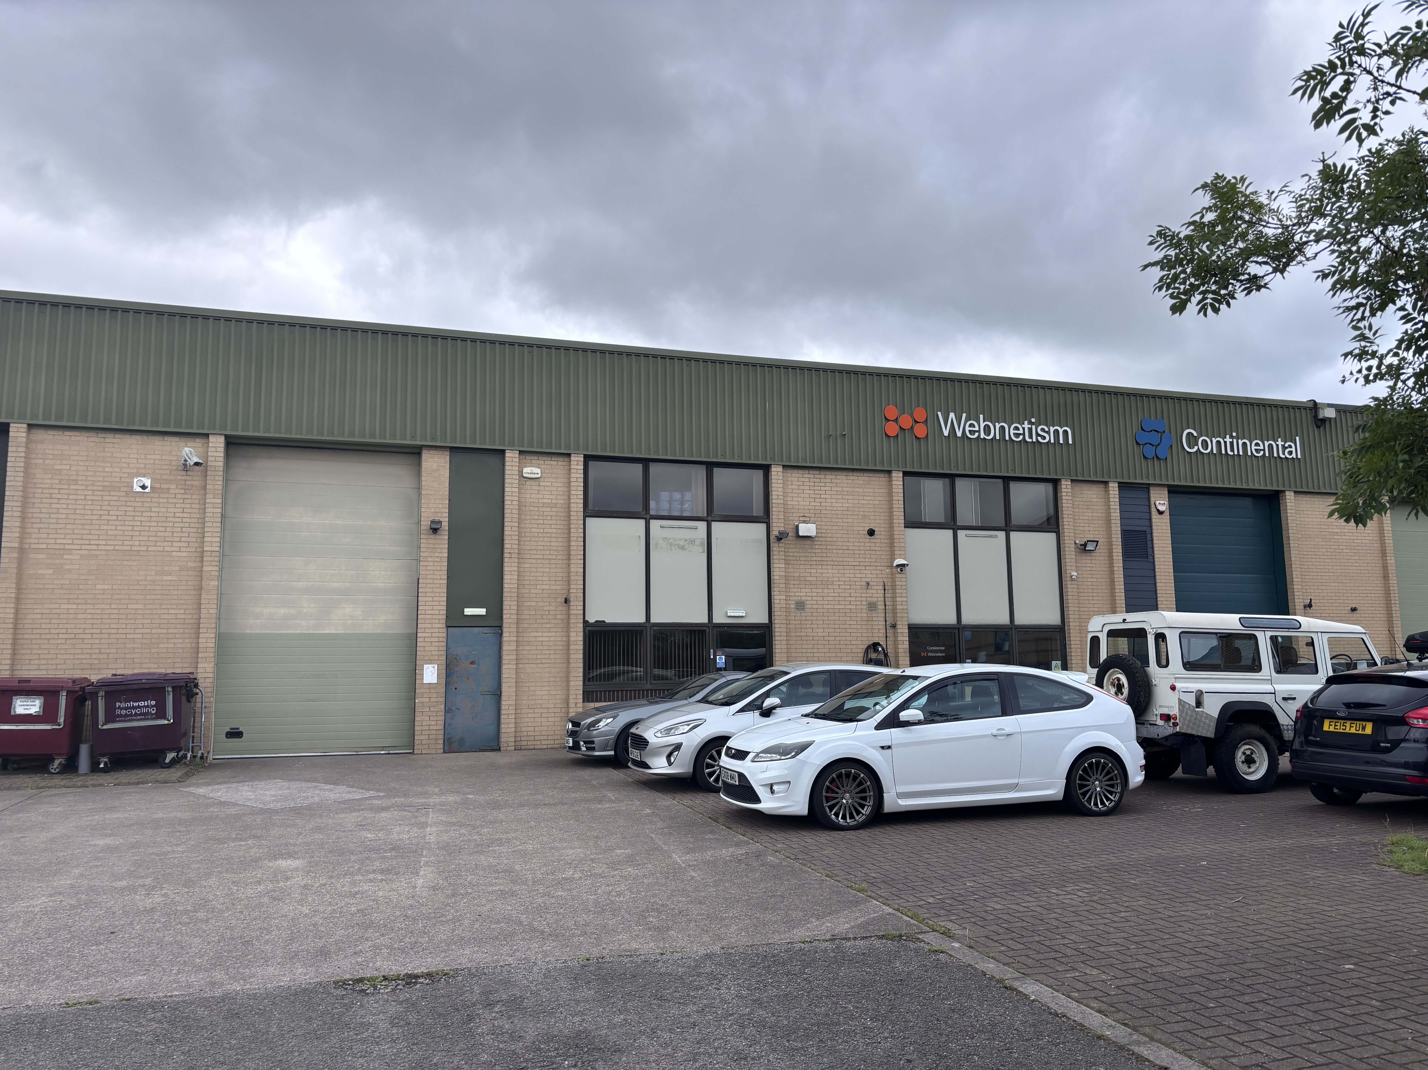
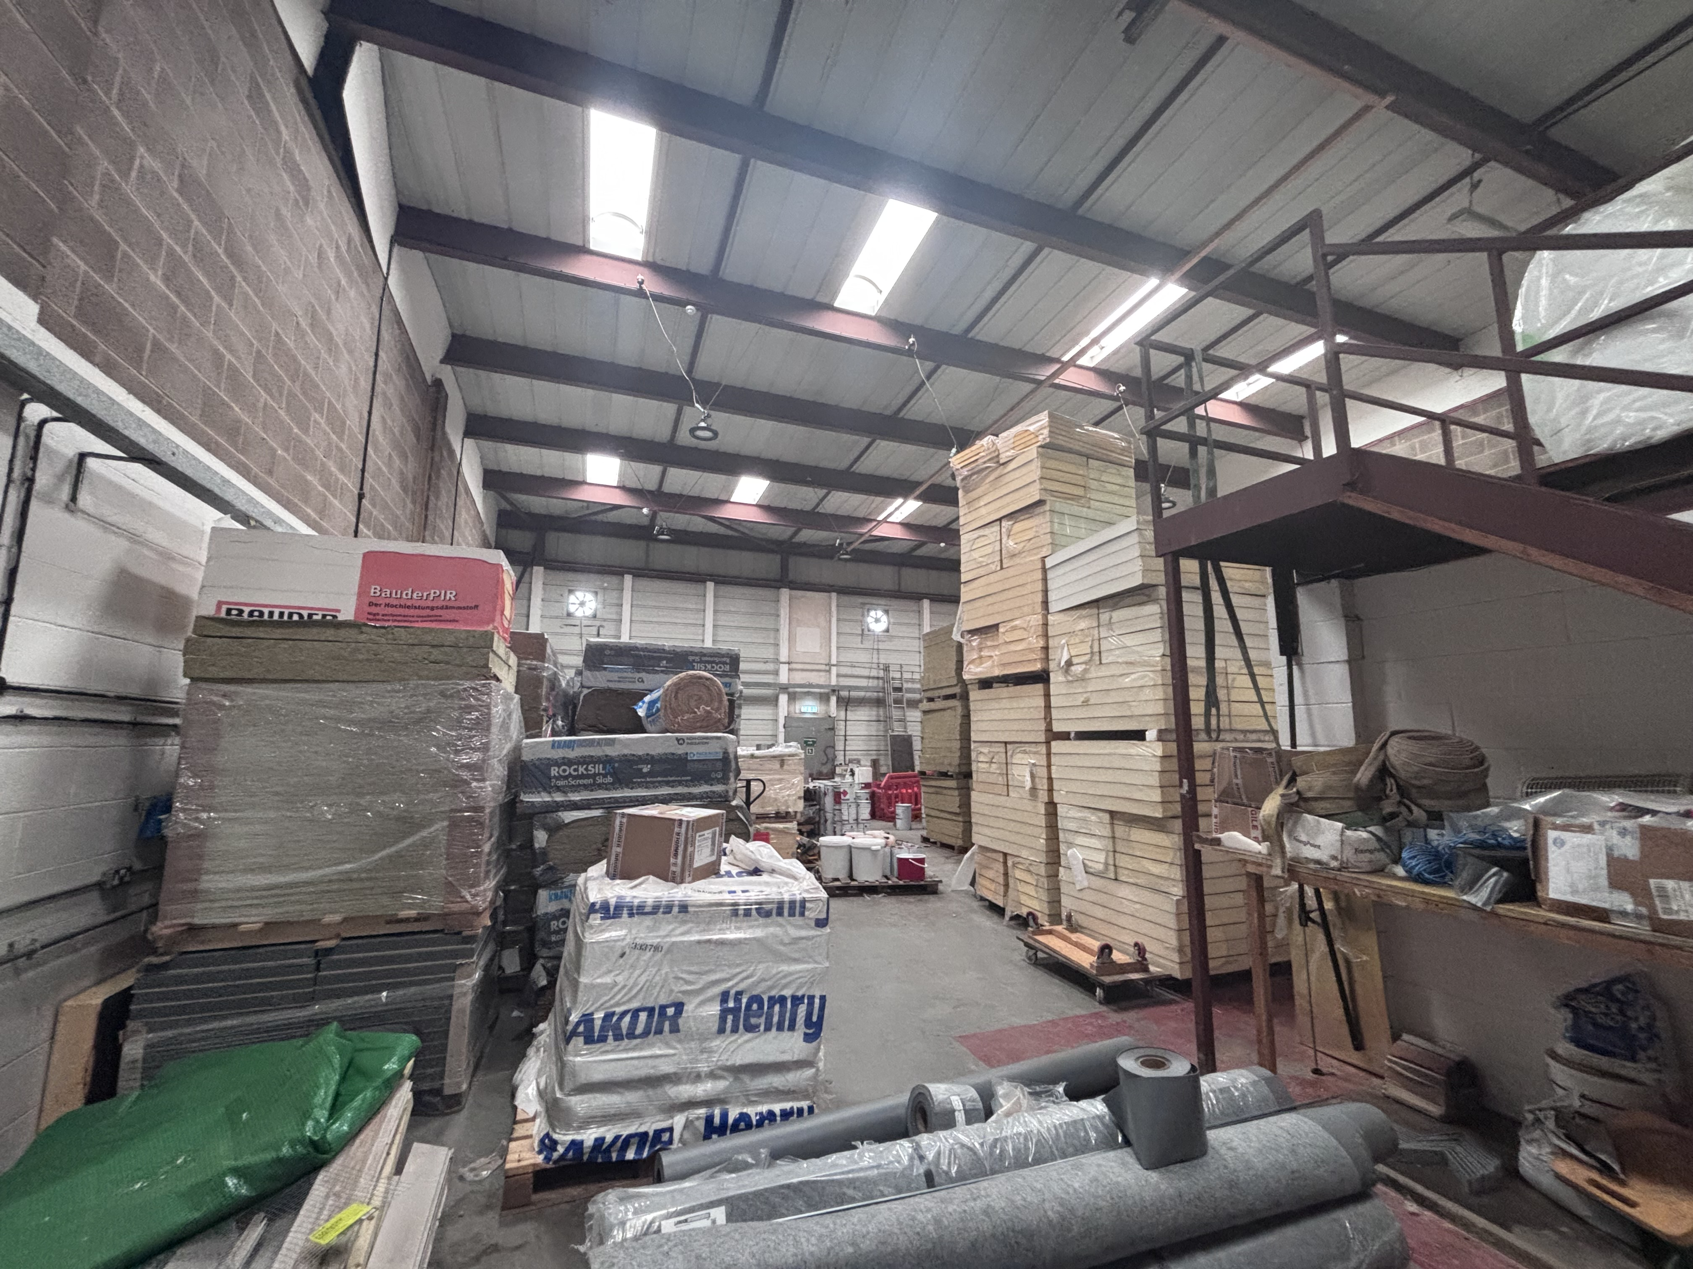
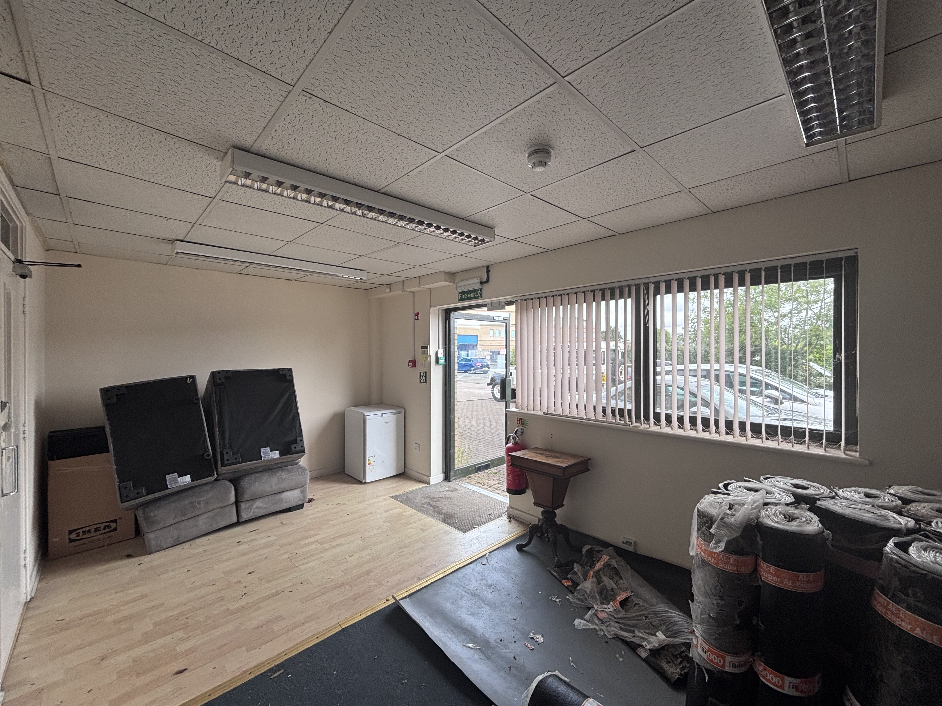
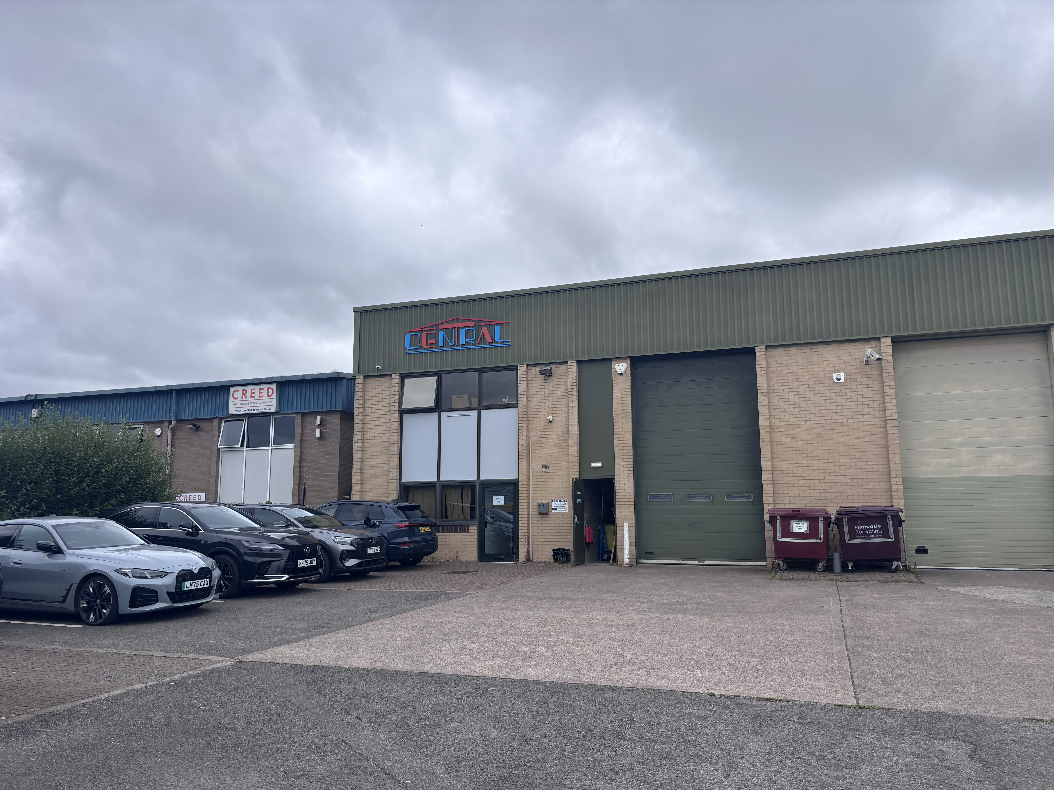
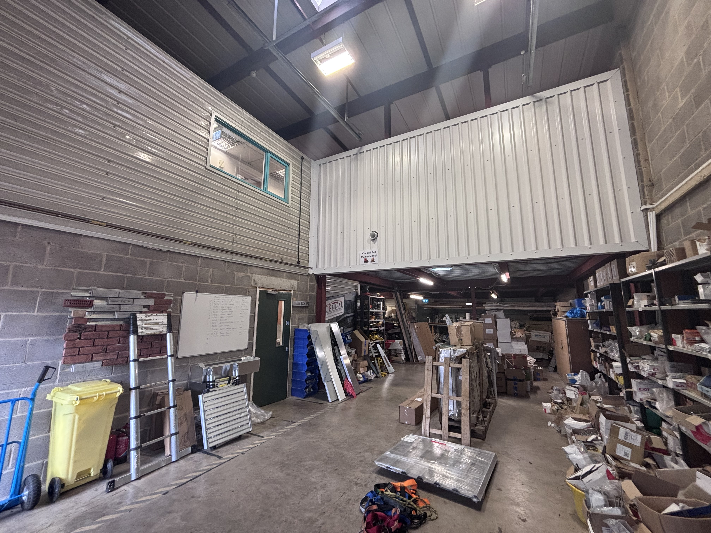
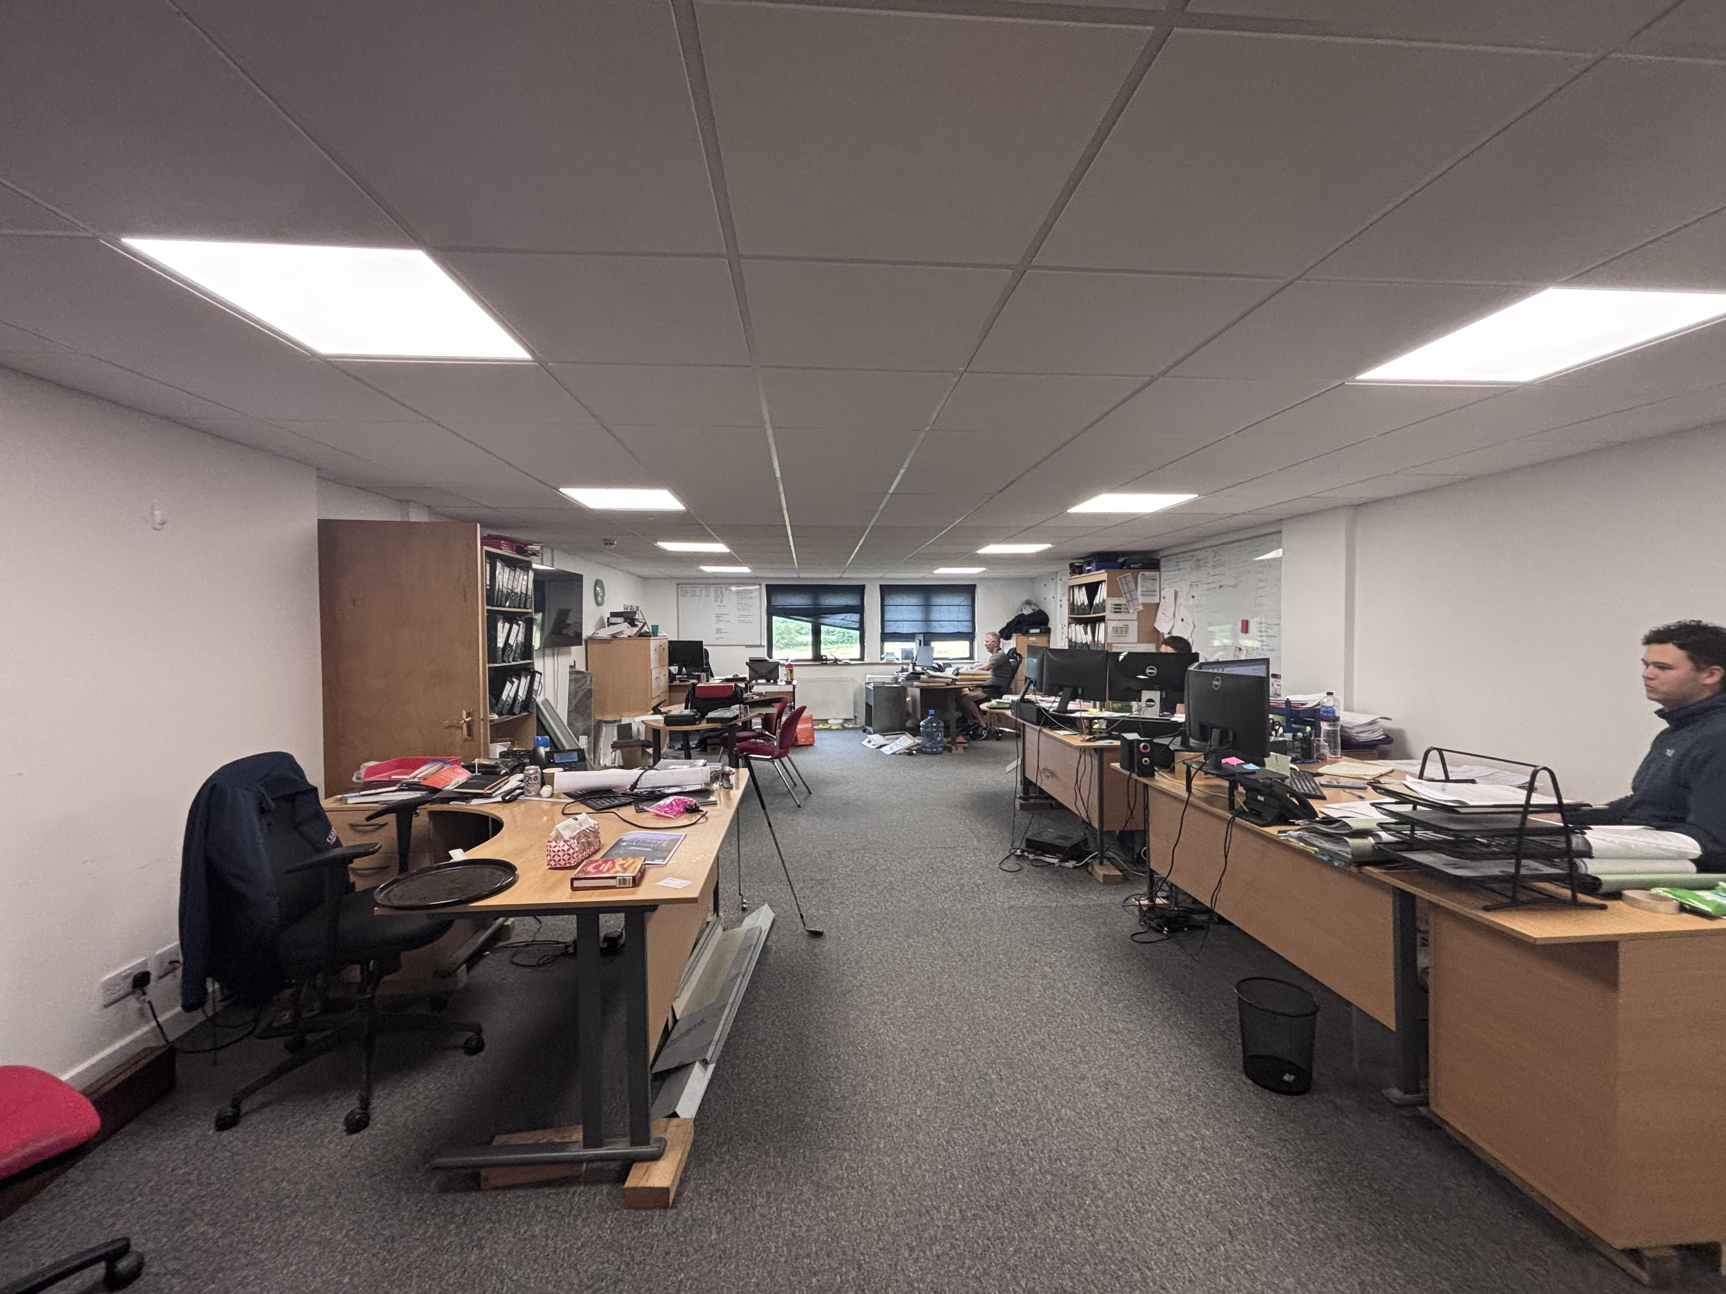
Units C3 & C4 Staverton Technology Park
Unit C3
Unit C3
Unit C3
Unit C4
Unit C4
Unit C4

Slide 5



Request a viewing
ASH Chartered Surveyors for themselves and for the vendors or lessors of this property for whom they act, give notice that:
these particulars are a general outline only, for the guidance of prospective purchasers or tenants, and do not constitute the whole or any part of an offer or contract;
ASH Chartered Surveyors cannot guarantee the accuracy of any description, dimensions, references to condition, necessary permissions for use and occupation and other details contained herein and prospective purchasers or tenants must not rely on them as statements of fact or representations and must satisfy themselves as to their accuracy;
no employee of ASH Chartered Surveyors has any authority to make or give any representation or warranty or enter into any contract whatever in relation to the property;
rents quoted in these particulars may be subject to VAT in addition; (v) ASH Chartered Surveyors will not be liable, in negligence or otherwise, for any loss arising from the use of these particulars; and
the reference to any plant, machinery, equipment, services, fixtures or fittings at the property shall not constitute a representation (unless otherwise stated) as to its state or condition or that it is capable of fulfilling its intended function. Prospective purchasers/tenants should satisfy themselves as to the fitness of such items for their requirements.
Code of Practice for Commercial Leases in England and Wales
You should be aware that the Code of practice on commercial leases in England and Wales strongly recommends you seek professional advice from a qualified surveyor, solicitor or licenced conveyancer before agreeing or signing a business tenancy agreement. The Code is available through professional institutions and trade associations.
Money Laundering Regulations 2017
As part of our obligations under the UK Money Laundering Regulations, ASH Chartered Surveyors requires any purchaser or tenant to provide information and documentation to satisfy our legal obligations.
Misrepresentation Act 1967
This marketing brochure is for guidance only and does not form part of any offer or contract and must not be relied upon as statements or representations of fact.
Control of Asbestos Regulations 2012 (CAR 2012)
It is the responsibility of the owner or tenant of the property, and anyone else who has control over it and/or responsibility for maintaining it, to comply with the regulations. The detection of asbestos and asbestos-related compounds is beyond the scope of ASH Chartered Surveyors and accordingly, we recommend you obtain advice from a specialist source.
For further information or to request a viewing, please get in touch
Key contacts
Simon McKeag BSc (Hons) MRICS
simon@ashproperty.co.uk
07737 691453
Oliver Hambling
OliverHambling@ashproperty.co.uk
01452 300433

